Slide 1
High Tech and High Touch: Re-Designing a Large-Enrollment Course

Slide 2
Overview
Course (2011):
480 seats each semester
12 independent sections of 40 students: 6 GTAs and 12 Undergraduate Assistants each semester
2 Class Meetings A Week
Shared Syllabus
Loosely shared assignments and approach to assessment
No room for growth

Slide 3
Overview
Course (2011):
480 seats, 12 independent sections of 40 students: 6 GTAs and 12 Undergraduate Instructional Assistants
2 Class Meetings A Week
Shared Syllabus
Loosely shared assignments and approach to assessment
No Room for Growth
Why Re-Design?
Anticipated 10-15% annual increase in enrollment demand
Need to increase consistency in content and assessment
Desire for students to learn directly from GTAs, remove IAs
Need to improve GTA support and mentorship

Slide 4
Overview
Course (2011):
480 seats, 12 independent sections of 40 students: 6 GTAs and 12 Undergraduate Assistants
2 Class Meetings A Week
Shared Syllabus
Loosely shared assignments and approach to assessment
No Room for Growth
Why Re-Design?
Pedagogical Challenges:
Limited access to large lecture halls on campus
Limited instructional resources to accommodate growth
Course learning outcomes include public speaking and team collaboration

Slide 5
Overview
Course (2011):
480 seats, 12 independent sections of 40 students: 6 GTAs and 12 Undergraduate Assistants
2 Class Meetings A Week
Shared Syllabus
Loosely shared assignments and approach to assessment
No Room for Growth
Why Re-Design?
Pedagogical Challenges
Build from Successful Online Version of Course

Slide 6
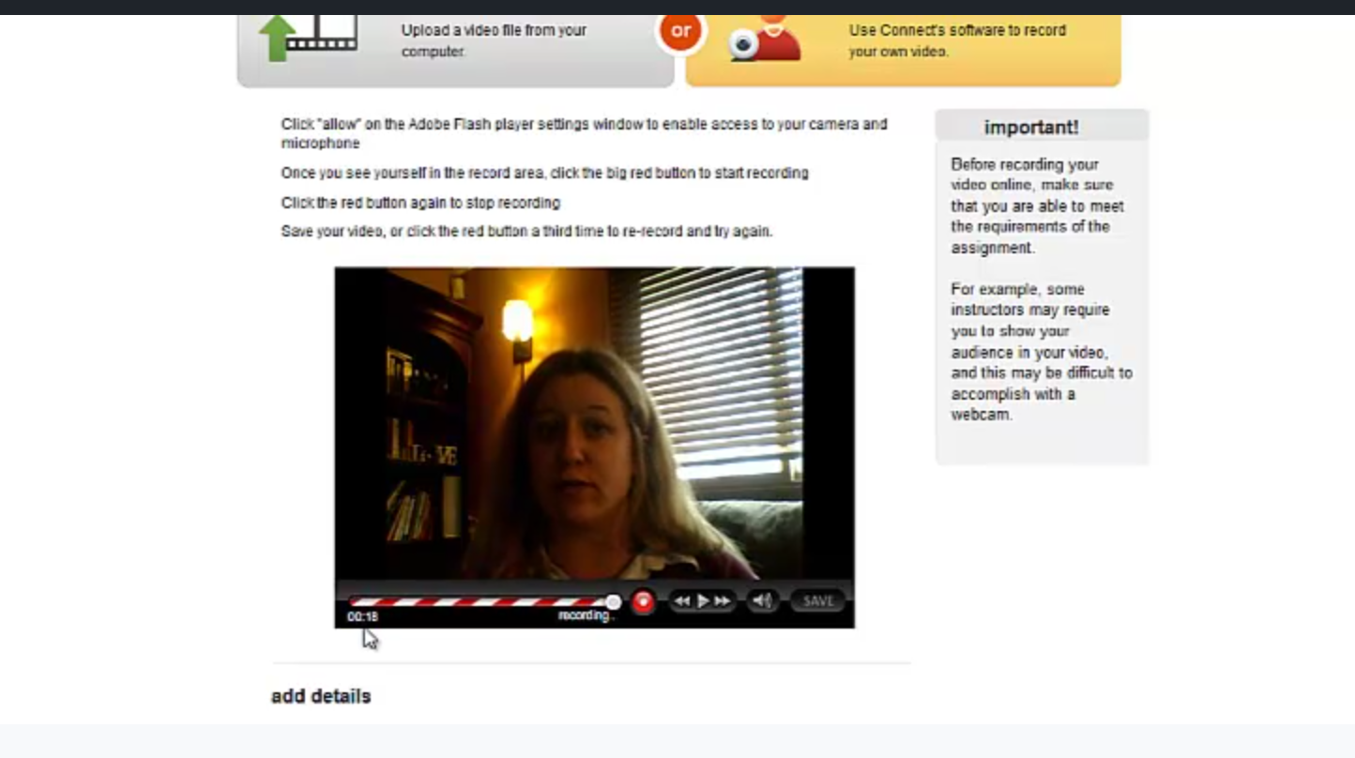

Slide 7
Solution: High Tech-High Touch Hybrid Course Delivery Format

Slide 8
Solution: High Tech-High Touch Hybrid Course Delivery Format
First 7 Weeks: Content Mastery and Low Stakes Skill Development Activities | Last 9 Weeks: Advanced Skill Development Opportunities with Assessment

Slide 9
Solution: High Tech-High Touch Hybrid Course Delivery Format
First 7 Weeks: Content Mastery and Laying Foundation for Skill Development
Read
Watch Weekly Lecture Online
Weekly Class Meeting with a Quiz
Class Activities aimed at Practicing Key Skills

Slide 10
Online Weekly Lectures Delivered via TechSmith Relay

Slide 11
Solution: High Tech-High Touch Hybrid Course Delivery Format
First 7 Weeks: Content Mastery and Low Stakes Skill Development Activities | Last 9 Weeks: Advanced Skill Development Opportunities with Assessment
Read | Impromptus
Watch Weekly Lecture Online | Individual Speech Delivery
Weekly Quiz | Team Collaboration
Class Activities aimed at Practicing Key Skills | Team Presentation

Slide 12
Hybrid Course Delivery Format
Organized by Week-By-Week Tasks
Student Empowerment and Access to instruction directly from GTAs:
Canvas Course organized by Weeks
Student Skill Center/Technology Support Center
Low-Stakes Early Assignments Encouraging Student Accountability
Assignments that Build on Each Other
Consistent, Timely, Effective Feedback to Build From
In-Class Time for “On the Spot” Feedback
Weekly Instructor Emails and Plentiful Office Hours
Speech Lab Support
First 7 Weeks: Content Mastery and Low Stakes Skill Development Activities | Last 9 Weeks: Advanced Skill Development Opportunities with Assessment
Read | Impromptus
Watch Weekly Lecture Online | Individual Speech Delivery
Weekly Quiz | Team Presentation
Class Activities aimed at Practicing Key Skills | Team Presentation

Slide 14
Hybrid Course Delivery Format
Organized by Week-By-Week Tasks
Improved Course Consistency:
Common Lecture
Shared Syllabus and Course Policies
Shared Assignments and Grade Rubrics
Weekly Course Instructor Meetings
First 7 Weeks: Content Mastery and Low Stakes Skill Development Activities | Last 9 Weeks: Advanced Skill Development Opportunities with Assessment
Read | Impromptus
Watch Weekly Lecture Online | Individual Speech Delivery
Weekly Quiz | Team Presentation
Class Activities aimed at Practicing Key Skills | Team Presentation

Slide 15
Hybrid Course Delivery Format
Organized by Week-By-Week Tasks
Improved Course Consistency:
Common Lecture
Shared Syllabus and Course Policies
Shared Assignments and Grade Rubrics
Weekly Course Instructor Meetings
Improved GTA Support
Formal GTA mentorship from Course Director
Informal GTA mentorship from experienced GTAs
Canvas Course for Instructors
First 7 Weeks: Content Mastery and Low Stakes Skill Development Activities | Last 9 Weeks: Advanced Skill Development Opportunities with Assessment
Read | Impromptus
Watch Weekly Lecture Online | Individual Speech Delivery
Weekly Quiz | Team Presentation
Class Activities aimed at Practicing Key Skills | Team Presentation

Slide 16
Hybrid Course Delivery Format
Organized by Week-By-Week Tasks
Improved Course Consistency:
Common Lecture
Shared Syllabus and Course Policies
Shared Assignments and Grade Rubrics
Weekly Course Instructor Meetings
Improved GTA Support
Formal GTA mentorship from Course Director
Informal GTA mentorship from experienced GTAs
Canvas Course for Instructors
First 7 Weeks: Content Mastery and Low Stakes Skill Development Activities | Last 9 Weeks: Advanced Skill Development Opportunities with Assessment
Read | Impromptus
Watch Weekly Lecture Online | Individual Speech Delivery
Weekly Quiz | Team Presentation
Class Activities aimed at Practicing Key Skills | Team Presentation

Slide 18
Measuring Our Success
Moved from 480 seats to 576 seats each semester
Created a sustainable course format that has room for growth
Student performance in course indicates consistent student achievement of all course learning outcomes across all sections
2015-2016 Peer Review of Teaching Course Assessment
Reduction in student communication apprehension
Increase in student confidence in ability to develop and deliver professional presentations
Students report the hybrid delivery format effectively facilitates their learning across course learning outcomes

Slide 19
Questions?
Thank You!
Katherine M. Castle, Ph.D.
University of Nebraska-Lincoln
kcastle4@unl.edu

