Slide 1
Audio & Video Accessibility
Building Inclusion through Digital Accessibility Series
Julia Remsik Larsen (she/her) & Amy Ort (she/her)
Notes:
Julia

Slide 2
Learning Objectives
Explore digital accessibility features in Yuja
Assess the accessibility of audio & video content created by others
Notes:
Julia

Slide 3
Why make your audio and video accessible?
Improves student learning
Particularly supports the large and growing number of students with disabilities
Improves retention
Inclusive environment
It's the law
Notes:
Julia

Slide 4
Please ask questions in the chat!
Notes:
Julia

Slide 5

Accessibility Checklist
Open the Digital Accessibility Checklist for Commonly Used Programs
  Audio/Video Checklist is also available
Notes:
Amy

Slide 6
But I'm using materials I didn't create...
Check for accessibility anyway – the same standards apply
Next steps
  Contact the author – Will they remediate?
  Check with the libraries to see if they have an alternate version
  Find or create new content
Notes:
Julia

Slide 7
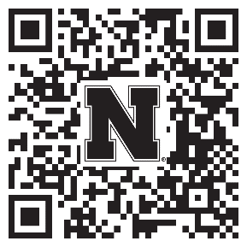
Help Strengthen Student Success At UNL!
Participate in a research study examining:
  The accessibility of digital course materials in Canvas
  How they impact students
Anyone teaching a credit-bearing course at UNL can participate
Conducted by the Center for Transformative Teaching (CTT)
To sign up: go.unl.edu/coursedesignstudy
Unsure? Questions? Contact amitchell22@unl.edu or aort@unl.edu
Notes:
Julia
Because of your interest in promoting your students’ success, I wanted to invite you to participate in a research study examining the accessibility of digital course materials in Canvas and how they impact students. Anyone who teaches a credit-bearing course at UNL is eligible to participate. Participation can take 5 minutes to an hour, depending on your level of participation. The go link, QR code, and contact information for the lead investigators are on the screen if you would like to learn more or participate.

Slide 8
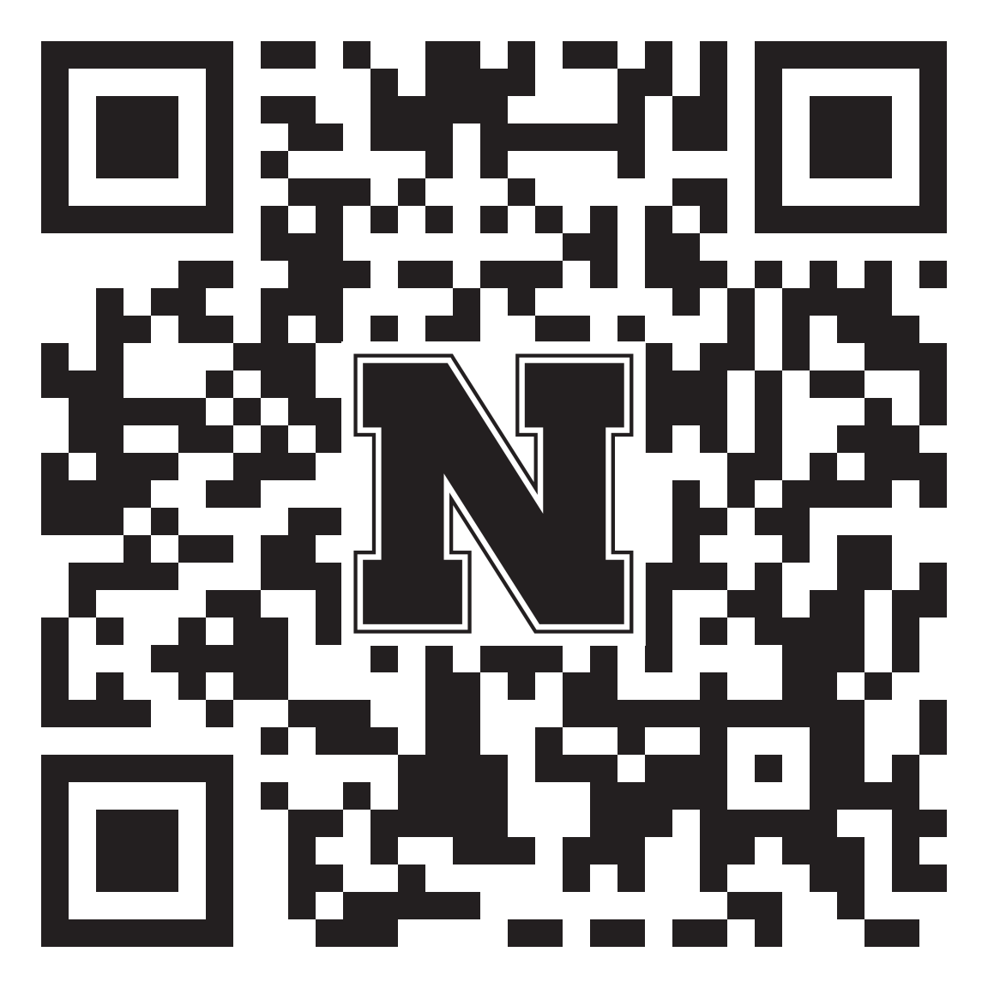
How did we do?
Your feedback is appreciated!
Please take a moment to fill out a short evaluation survey for this workshop:
go.unl.edu/bidaAV
Notes:
Julia

Slide 9

Questions?

Slide 10
Audio / Video Practice Session
Building Inclusion through Digital Accessibility Series
Notes:
Clarisa

Slide 11
How will this session work?
We will open a breakout room for each participant
Open your own audio or video file and use the Digital Accessibility Checklist for Commonly Used Programs to identify and remediate accessibility issues
Use the "Ask for Help" button for questions and an instructional designer will join your room
Notes:
Clarisa

Slide 12
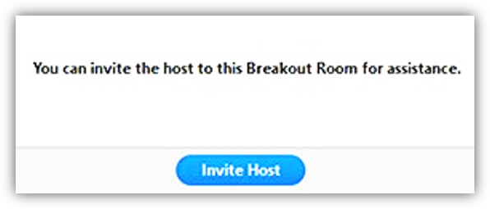
How do I get help?
Click "Ask for Help" button in the meeting controls.
Confirm that you would like assistance by clicking Invite Host.
Notes:
Clarisa

Slide 13
If you'd prefer to work in a collaborative room, stay in the main session for now
Notes:
Clarisa

