Slide 1

You'll need adobe acrobat installed. https://www.Adobe.Com/
Notes:
The cloud version will not do what you need to remediate.
Share slides PDF accessibility presentation BIDA Sp 2025.pptx

Slide 2
PDF Accessibility
Building Inclusion through Digital Accessibility Series

Slide 3


Today's Presenters
Zach Manley
Instructional Designer supporting the College of Business
Center for Transformative Teaching
Grace Troupe
Instructional Designer supporting the Honors Program
Center for Transformative Teaching

Slide 4
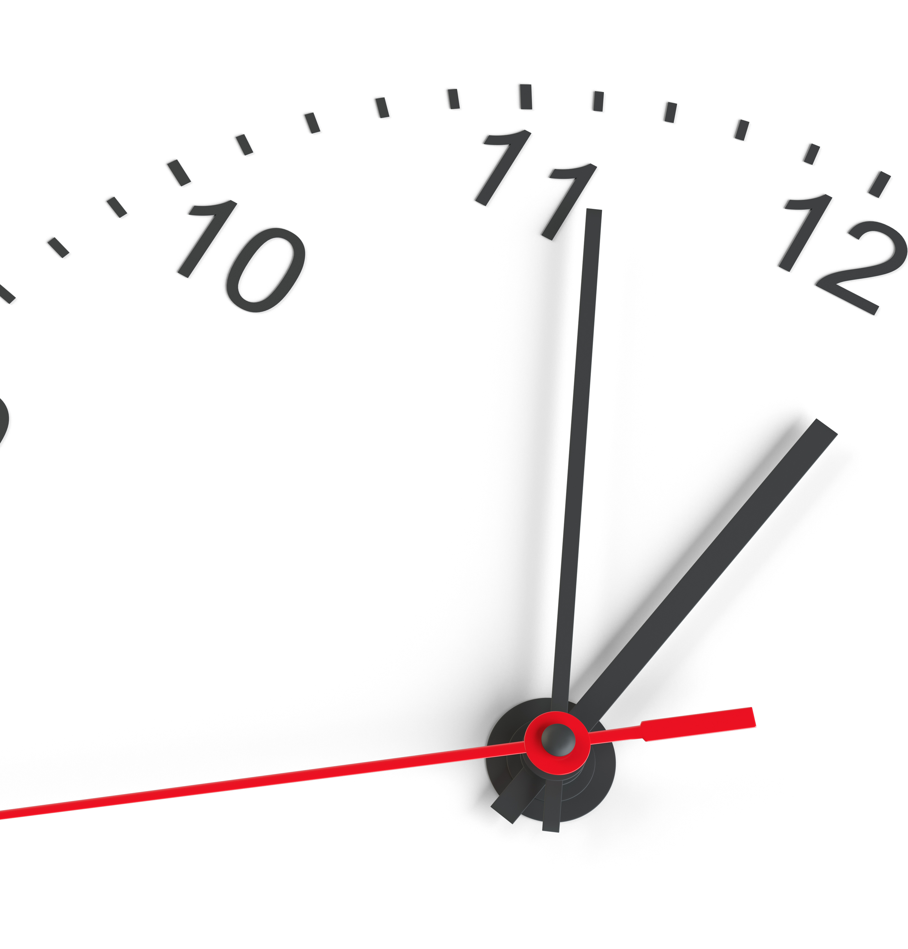
PDF accessibility requires the most technical skill and time.
Notes:
The user interface is not user friendly
The base document is not changeable
Scans strip out the background coding for accessibility, so you have to add it back in from scratch
If you are going to use a PDF, it needs to be worth the time and energy

Slide 5
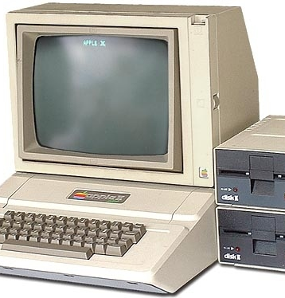
Addressing the 5 Most Common Old Reasons for Using PDFs.
Notes:
We’ve talked to our campus partners ITS, Libraries, and IEC. From these conversations, we've learned that most of the reasons people use PDFs are actually outdated – based on how computers used to work.
PDFs were first introduced in 1992 – they are as old as this computer. They are 33 years old.

Slide 6
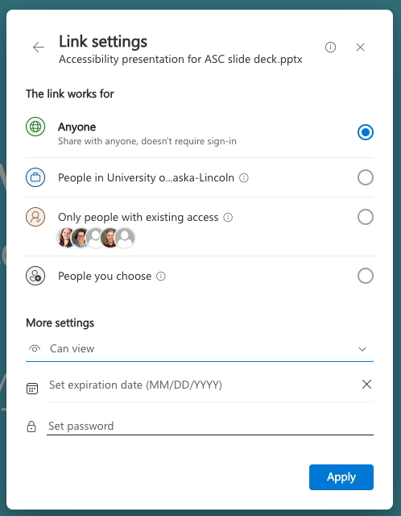
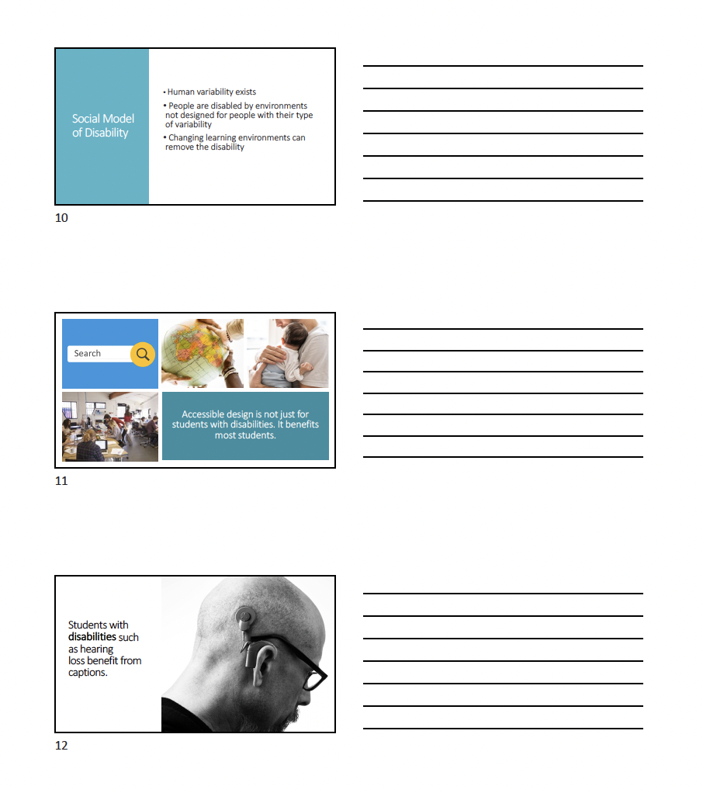
Reason for using a PDF:
Locking down your intellectual property
Notes:
A printed PDF sheet of PowerPoint notes with the slides on the left and blank lines on the right. Sharing notes in this format allows the least flexibility and usability for students. It is also very hard to make accesssible. This only provides the illusion of locking down your intellectual property. It is very easy to get the content out these days.
The menu for sharing a “view only” link for a PowerPoint presentation. This is a much better option for sharing content with your students because it retains its original accessibility features and students can download it and use it most flexibly.

Slide 7


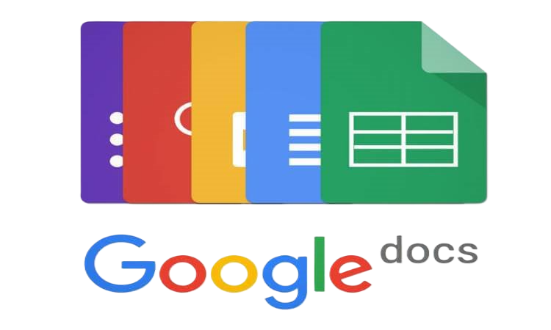
Reason for using a PDF:
Allowing the file to be opened on any device
Internal Use
External Use
Notes:
Google platforms are free and can open most document formats. There are also cloud versions of Microsoft products.

Slide 8


Reason for using a PDF:
Creating forms

Slide 9
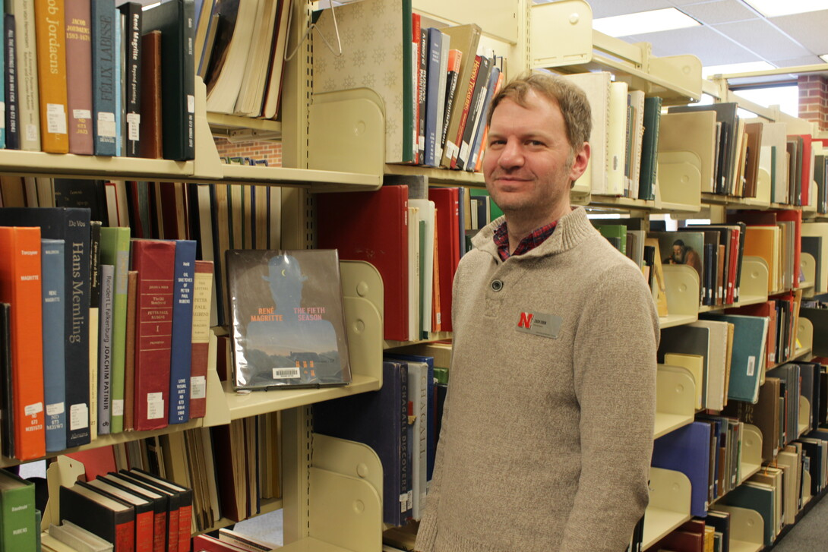
Reason for using a PDF:
Sharing journal articles
Notes:
If students are using a PDF in the course, then it circumvents journal web traffic through the library. Then the library doesn't have usage data supporting the need to subscribe to that journal.
Web version of the article has accessibility features built in.

Slide 10
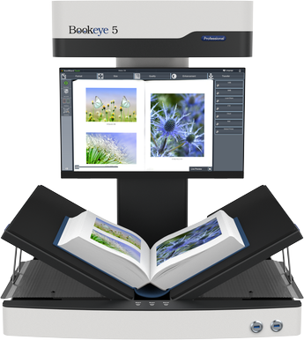


Reason for using a PDF:
Sharing scanned book chapters
Notes:
e-reader with an eBook. Always check for existing eBook options before creating a scan.
Audiobook symbol. Always check for additional formats for your reading when creating a scan.
Requesting a scan of a book chapter through the library means you’ll get a higher quality scan made by the Bookeye scanner. This will result in better OCR results.

Slide 11

Reason for using a PDF:
Consistency for printing
Notes:
Colorful rare bird. This represents the rare occasion in which consistency of layout would trump the usefulness of flexibility of the original file type.
In situations where you need to maintain the print layout – you are probably going to print it yourself. If you are providing the file, then give the original file type.
When is the last time you printed something?
Final reason is that pdfs make it easy to lock down your file so the words don’t move around. Yes, this is good for printing.
HOWEVER, if you’re going to share this digitally with your students, you’ll need to go through ALL of the steps we talked about.
Depending on the size of the document, this could take hours.
You need ask yourself if spending hours on making pdf accessible is worth your words not moving around.
If you want to save yourself hours, just give them original file.
This is why I rate this reason: Proceed with caution.

Slide 12
Use the Adobe Acrobat desktop app
If you don’t have it installed, go to: https://www.Adobe.Com/
Notes:
The cloud version will not do what you need to remediate.

Slide 13
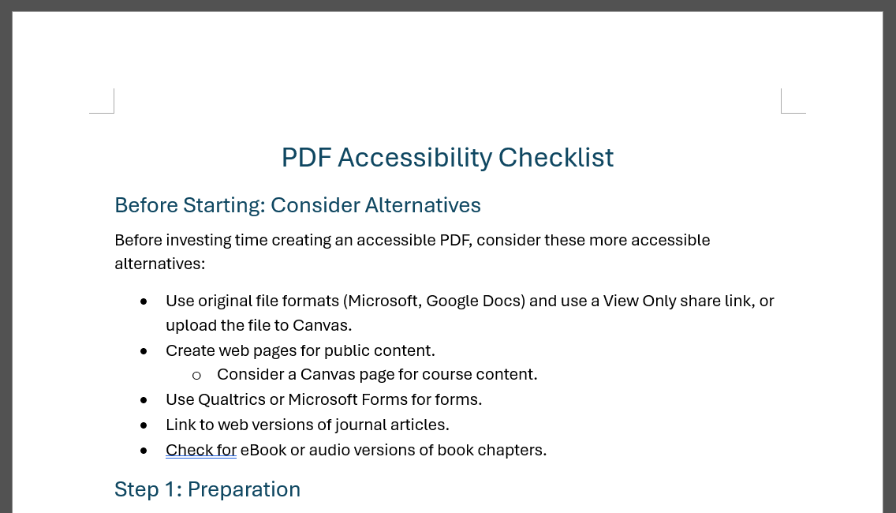
Download The PDF Checklist.
Notes:
We've recently updated the PDF checklist (April 2025). If you've retrieved the PDF checklist prior to our workshop this week, be sure to grab the updated version from the CTT website.

Slide 14
Download the Demo Document to remediate with us.
Notes:
The cloud version will not do what you need to remediate.

Slide 15
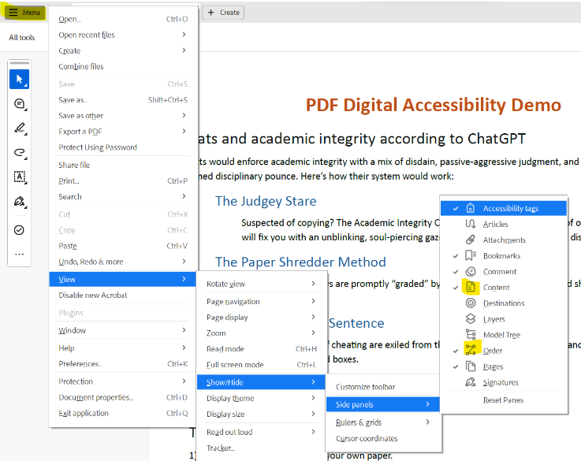
Pin the acrobat accessibility tools.
Notes:
On PC: Menu -> View -> Show/Hide -> Side panels -> Accessibility tags, Content, Order
You will need to repeat the process the Content and Order panels.

Slide 16
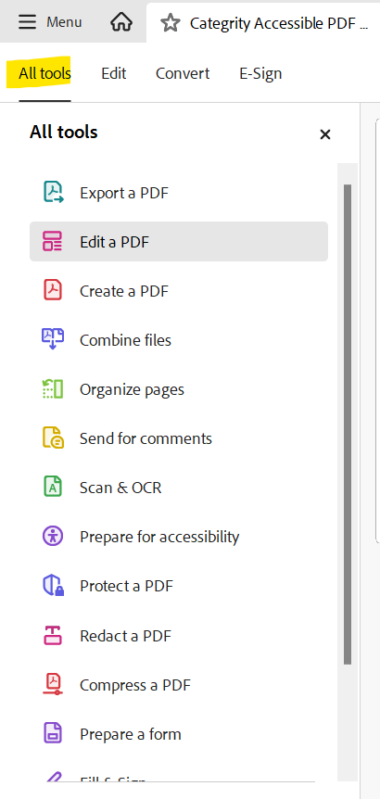
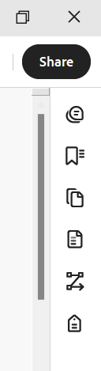
Acrobat Tools Layout
On the right side:
Content Panel
(Reading) Order Panel
Accessibility Tag Panel
Find Prepare for accessibility in the tools list and drag and drop it under Scan & OCR.
Notes:
The right-side toolbar should look like the image on the right if the primary accessibility tools have been enabled.
From the All tools menu, we recommend finding Prepare for accessibility in the list (you might need to select View more) then drag and drop it under Scan & OCR.

Slide 17
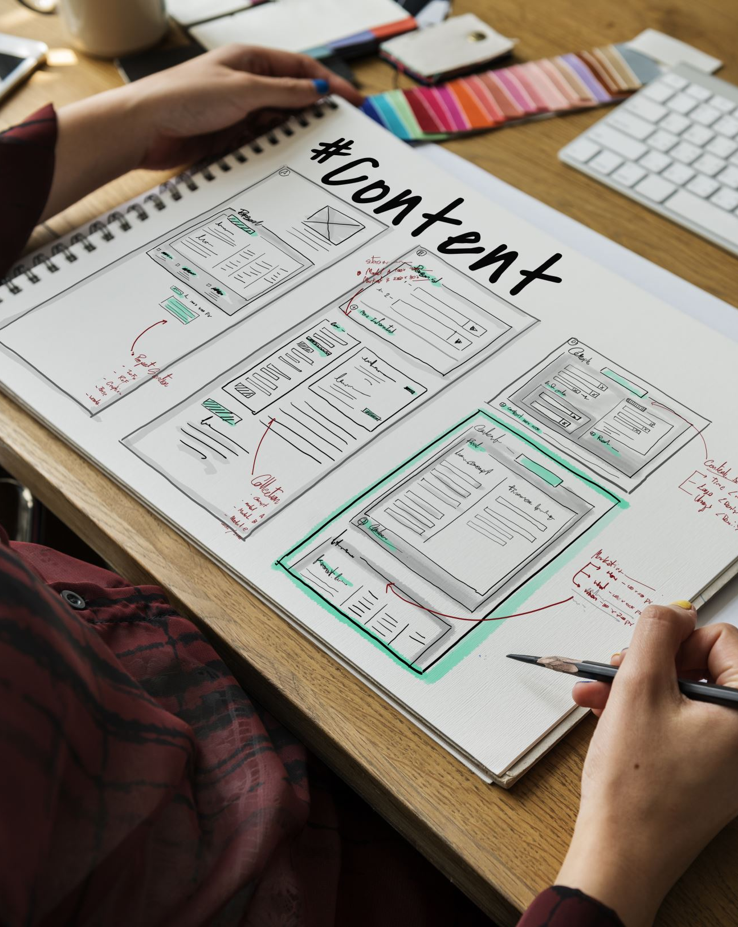
What are accessibility tags?
Accessibility tags tell assistive technologies how to interact with the content in the document.
Accessibility tags also assist with usability and navigation.
We implement tags for the benefit of a human user.

Slide 18
Print to PDF vs Save as PDF
Print to PDF
Save As PDF / Export As PDF
Does not create accessibility tags.
Essentially strips away all digital accessibility features from the source document.
Note: Many tools and platforms have options to create PDFs. The PDFs created are of varying quality and many do not create accessibility tags.
You must always verify the tag tree!
Provides options for digital accessibility
Creates accessibility tags based on the accessibility features implemented in the source document.
Can also create bookmarks from the document headings.
The best option for accessibility when available!
Notes:
Working with PDFs is a unique experience for each file. One method (Pint to PDF + auto tagging or Save As PDF) might not always work well every time. Different conversion types use different conversion engines with different parameters for applying accessibility standards. If one method isn't providing great results, try another.

Slide 19
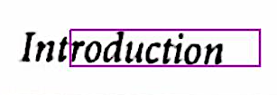
PDFs from Scans
Likely the most challenging PDFs to make accessible.
Verify that Optical Character Recognition (OCR) has been run, and that the OCR is accurate.
  Scan quality can impact OCR.
No accessibility tags. You will need to add them.
Notes:
PDFs (especially scanned PDFs) essentially start as an image.
OCR is a tool that allows the text in the image to be read as text.
OCR should be complete and accurate for all text. If there are fragments, like in the image above, the text is not usable.
Personally scanned document, especially books, need to have the OCR verified.

Slide 20
Items you should always check:
Quality of OCR
Document Properties
Accessibility Tag tree
  Tables
  Lists
Reading Order

Slide 21
Commonly Used Structure Tags
Heading Level 1-6 <H1> - <H6>
Paragraph for basic text <P>
List <L>
  List Item <LI>
    Label <Lbl>
    List Item Body <LBody>
Table <Table>
  Table Row <TR>
    Table Header <TH>
      Define scope as column or row
    Table Data Cell <TD>
Figure for images <Figure>
  Artifact for decorative <Artifact>
Caption for figures or tables <Caption>
Link for hyperlinks <Link>
  Links also need a <Link-OBJR> tag. This tag holds the actual URL
  Link tags are commonly nest in Paragraph <P> tags.

Slide 22
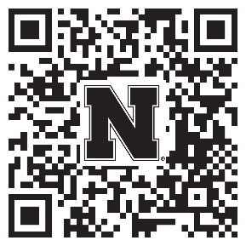
Help strengthen student success at UNL!
Participate in a research study examining:
  The accessibility of digital course materials in Canvas
  How they impact students
Anyone teaching a credit-bearing course at UNL can participate
Conducted by the Center for Transformative Teaching (CTT)
To sign up: go.unl.edu/coursedesignstudy
Unsure? Questions? Contact amitchell22@unl.edu or aort@unl.edu
Notes:
Because of your interest in promoting your students’ success, I wanted to invite you to participate in a research study examining the accessibility of digital course materials in Canvas and how they impact students. Anyone who teaches a credit-bearing course at UNL is eligible to participate. Participation can take 5 minutes to an hour, depending on your level of participation. The go link, QR code, and contact information for the lead investigators are on the screen if you would like to learn more or participate.

Slide 23

How did we do?
Your feedback is appreciated!
Please take a moment to fill out a short evaluation survey for this workshop.

Slide 24
Questions?

Slide 25
PDF practice session April 16, 2025

Slide 26
Improving PDF Accessibility
Today, we will be working in breakout rooms.
Individual or collaborative
Instructional designer support
The BIG question:
Seek alternative formats or remediate the PDF?
Notes:
Reserved worktime for PDFs in courses.
Use the call for help button.

