Slide 1
UNL Branding

Slide 2
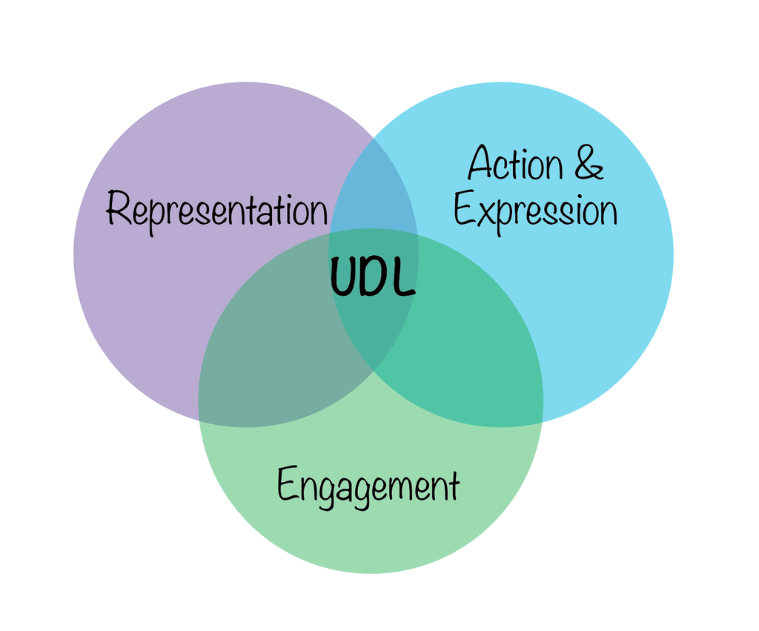
Reducing barriers to learning with UDL 3.0
BIDA Spring 25
Grace Troupe
Zach Manley
April 23, 2025
Notes:
Grace
Share link for slides: Spring BIDA 25 UDL.pptx

Slide 3
Today:
Guide you through the cycle of implementing UDL.
Identify a learning barrier -> match it to a UDL Consideration -> plan an instructional intervention.
Explore the connection between digital accessibility and UDL.

Slide 4
Today’s Agenda
Learning barriers
Introduction to UDL and examples
Explore the CAST UDL chart, connect to accessibility
Match learning barrier to UDL Considerations
Design course changes to overcome the learning barrier
Report out

Slide 5
UDL is a student-centered framework focused on developing students as learners by removing barriers to learning.
Notes:
Zach
UDL is more about thinking about what students need to succeed and less about compliance

Slide 6

Learning Barrier Categories Overview
Content
Emotional & Motivational
Identity & Authentic Self
Interpersonal
Expressing & Demonstrating Learning
Learning Environment
Notes:
Zach
Content: text, images, charts, video, audio, apps, platforms, verbal, visual Accessibility: access
Motivational: emotions, relevancy, value Accessibility: access
Authentic Self: Experience and current self (what’s going on now) Accessibility: access
Expressing: Paper writing for ELL, technology access, setting goals, managing projects Accessibility: tools, student submissions should also be accessible (teach students, they’ll need the skills!)
Learning environment: physical and virtual space Accessibility: (sight (font size, color contrast) and hearing considerations)

Slide 7
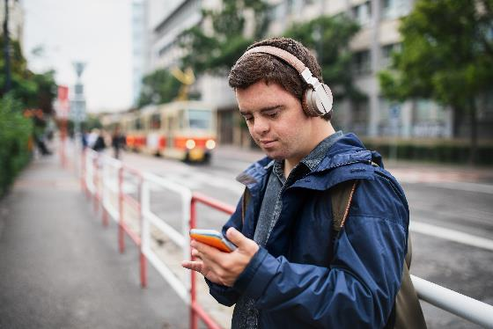

Learning Barrier Categories 1
Content:
  Format of the materials you provide
  Learning materials (language, vocabulary, making sense of the content)
Notes:
Content: text, images, charts, video, audio, apps, platforms, verbal, visual (audio book to study when available)
Learning materials: language, vocabulary, pattern recognition, connecting, general sense making

Slide 8

Learning Barrier Categories 2
Content
Emotional & Motivational
  Value and relevancy
  Connecting the course to themselves
Notes:
Motivational: emotions, relevancy, value (image shows how course content connecting to career plans is motivating)
Connecting to themselves (identity, lives, future, careers)
Access to information (demotivating when our needs are not met)

Slide 9

Learning Barrier Categories 3
Content
Emotional & Motivational
Identity & Authentic Self
  Providing diverse perspectives
  Using students’ pronouns
  Establish a sense of belonging
Notes:
Provide opportunities for students to be themselves through expression.
Diverse perspectives better allows students from all backgrounds connect with the content.
Increases belonging.
Image: a lot of effort goes into crafting a successful team identity

Slide 10

Learning Barrier Categories 4
Content
Emotional & Motivational
Identity & Authentic Self
Interpersonal
  How you communicate with students and they with you.
  How students interact with peers.
Notes:
Expectations for communications. Who communicates first?
Availability.
Language or cultural disconnects. Image: Office hours
Biases, different perspectives, language, preferred communication mediums, sense of belonging

Slide 11


Learning Barrier Categories 5
Content
Emotional & Motivational
Identity & Authentic Self
Interpersonal
Expressing & Demonstrating Learning
  The format of assessments
  Goal setting
Notes:
Expressing: Paper writing for ELL, technology access, setting goals, managing projects Accessibility: tools, student submissions should also be accessible (teach students, they’ll need the skills!)

Slide 12
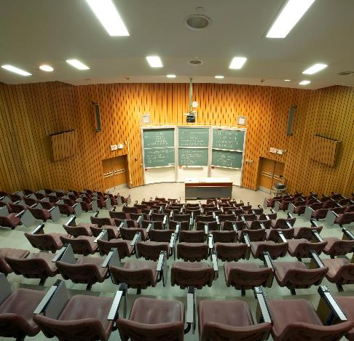
Learning Barrier Categories 6
Content
Emotional & Motivational
Identity & Authentic Self
Interpersonal
Expressing/Demonstrating Learning
Learning Environment
  Physical space: seeing the screen/slides, hearing in the room
  Virtual space: organization of content
Notes:
Learning environment: physical and virtual space Accessibility: (sight (font size, color contrast) and hearing considerations)
Use the classroom technology when they’re available.

Slide 13
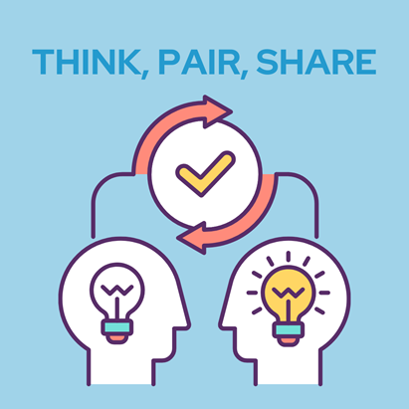
Think, Pair, Share
Consider the types of learning barriers.
Content
Emotional & Motivational
Identity & Authentic Self
Interpersonal
Expressing & Demonstrating Learning
Learning Environment
Identify 3 learning barriers in your course(s).
Notes:
Match the learning barrier with the type.
Think 3 minutes
Pair 3 minutes (breakout rooms)
Share 4 minutes (chat)
SAVE THESE! We’ll be using them again later.

Slide 14
Understanding the CAST UDL Chart
3 Principles
Multiple Means of Engagement
Multiple Means of Representation
Multiple Means of Action & Expression
9 Guidelines
Access, Support, Executive Function
36 Considerations (Checkpoints)
Notes:
Share link to chart: https://udlguidelines.cast.org/

Slide 15
Scavenger hunt
Get to know the CAST UDL graphic organizer. Spend 5 minutes exploring the UDL Framework.
Identify Considerations that apply to digital accessibility.
(Hint: 6 Considerations)

Slide 16
Digital Accessibility-related UDL Considerations
Multiple Means of Engagement
7.1 Optimize choice and autonomy.
Multiple Means of Representation
1.1 Support opportunities to customize the display of info.
1.2 Support multiple ways to perceive information.
2.5 Illustrate through multiple media.
Multiple Means of Action & Expression
4.1 Vary and honor the methods for response, navigation, and movement.
4.2 Optimize access to accessible materials and assistive and accessible technologies and tools.
Notes:
7.1 Choice between text or audio but also between video audio or CC or both.
1.1 Providing original file format. Using webpages.
1.2 Text, audio, video
2.5 It helps to have a variety, so students aren’t always working through the same challenges.
4.1 Students may prefer to reply via text or chat rather than use the microphone. Students may need to use the keyboard rather than the mouse or touch.
4.2 Provide accessible materials and implement digital accessibility as deeply as we can.

Slide 17
Discussion
Thinking about those UDL Considerations relating to digital accessibility…
Are you implementing any of them?
  If yes, how?
  If no, what do you need to start?
How does implementing digital accessibility assist students developing as learners?
Notes:
Feel free to add your ideas to the Zoom chat or come on the mic (1 minute thinking time)

Slide 18
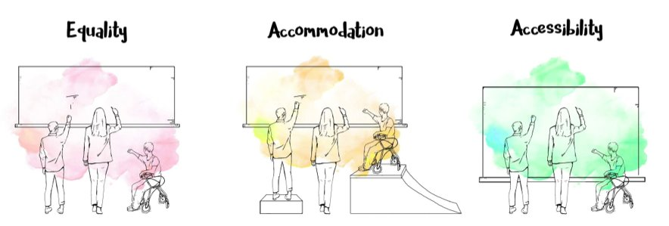
UDL starts with noticing a barrier.
Access
* Image by Maddie Brown in conjunction with McMaster University
Notes:
Grace

Slide 19
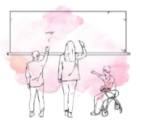
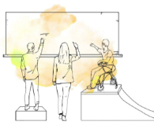
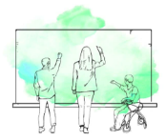
The process of UDL
Equality
Step 1.
Create a learning experience. Notice barriers.
Step 2.
React to the barrier in the short-term to support specific students.
Step 3.
Design to anticipate and remove the barrier for all learners.
Accommodation
Access

Slide 20
Accessibility with a UDL lens
Accessible design is not just for students with disabilities – it benefits most of your students!

Slide 21
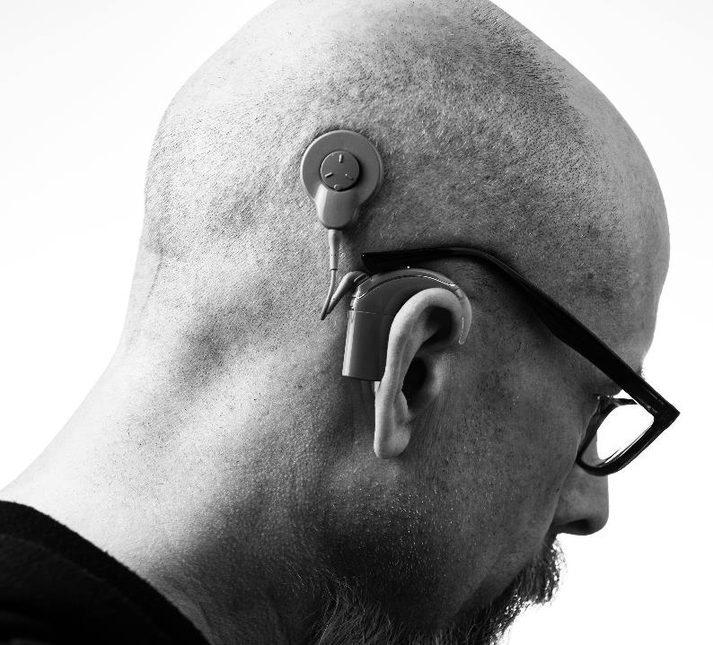
Students with disabilities such as hearing loss benefit from captions.

Slide 22

Multilingual learners benefit from captions.

Slide 23
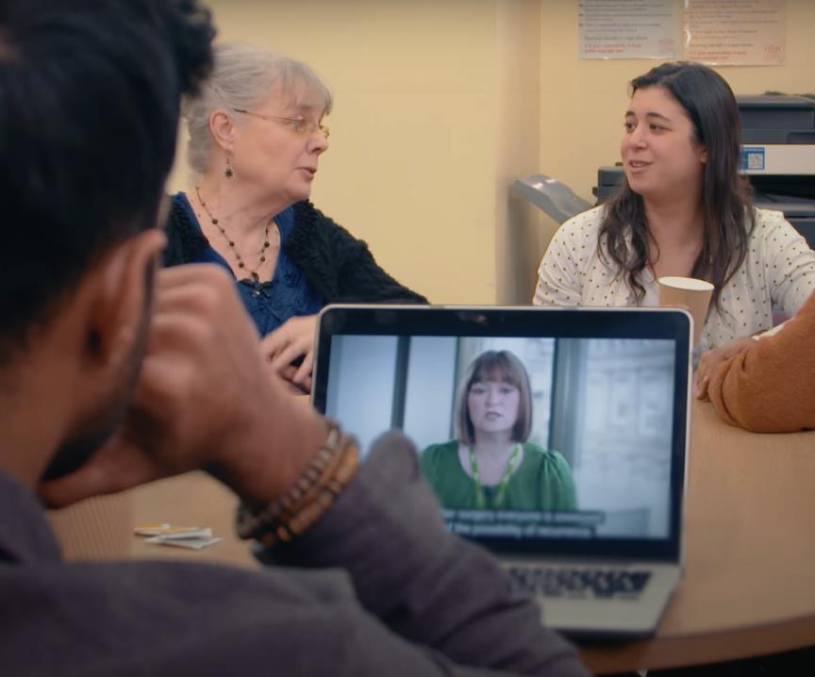
Students studying in loud spaces benefit from captions.

Slide 24
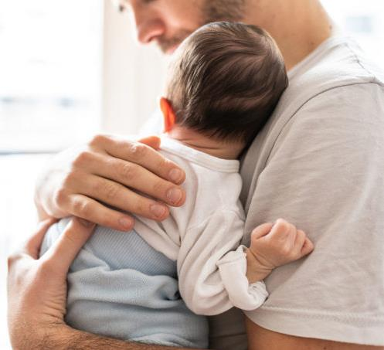
Students studying in quiet spaces benefit from captions.

Slide 25
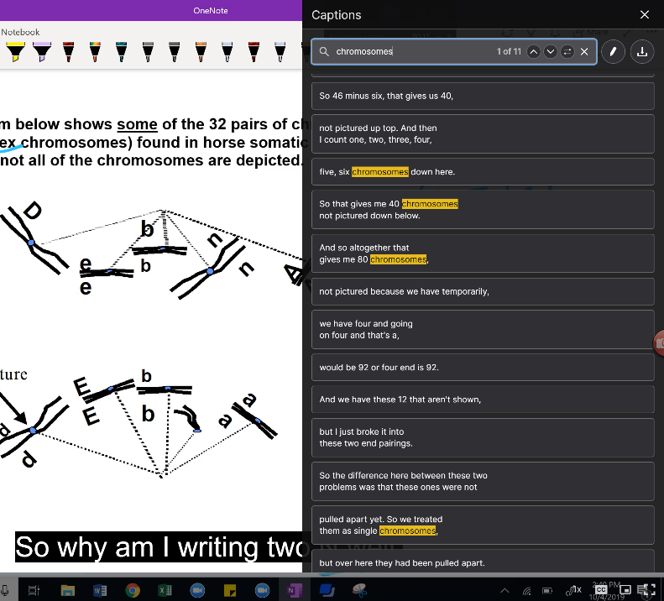
Students looking for a specific spot to review benefit from the ability to search the captions or read the transcript.

Slide 26


Barrier 1: Content
Barrier: text, time, language
Podcast version made by AI
Notes:
You notice that students aren't completing the readings for your class
You decide to add an audio option

Slide 27


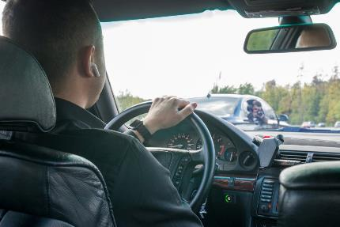
Students who benefit from the added audio option
Multi-tasking:
  Working a job
  Exercising
  Traveling
Preference
ADHD
Long COVID
ESL

Slide 28

Barrier 2: Emotional and motivational
Barrier: lack of interest
Notes:
You notice that a percentage of your students are not engaged
You feel disheartened because you know that the information in your class will be critical for their future careers

Slide 29

Barrier 2: Emotional and motivational
Solution: making the "why" apparent
Notes:
Connecting to future careers
Explicitly adding 'why' to all your content – lectures, assignments, modules
Creating assignments that ask them to integrate the knowledge in their future career scenarios

Slide 30
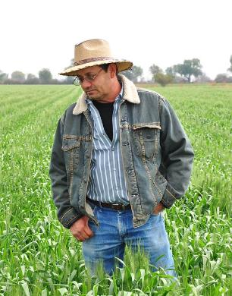
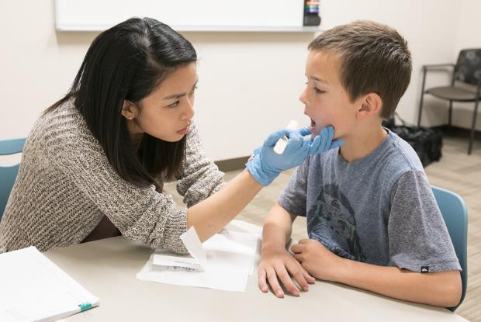

Barrier 3: Identity and authentic-self
Barrier: examples aren't relevant
Notes:
You notice class examples are not relevant for your students
You decide to increase student agency by allowing students to select the topic (gene) that's important to them.

Slide 31

Barrier 3: Identity and authentic-self
Solution: topic choice on student project
Notes:
Speech language pathologist students could choose a gene to focus on for their final project to apply what they know about genetic engineering and making primers. They could choose a gene for a human disease that they will work with in their future practice. This human application was much more motivating.
Giving students agency in their final project topic allows them to make the connections to what is most meaningful to them - rather than us trying to figure that out. This allows students to bring in their own identity to their choice.
Students came alive and put more effort into this part of the course. For example, students couldn't believe they could find the sequence of a gene for their brother's disease and that they had access to online tools that allowed them to make primers, which allow them to make copies.

Slide 32

Barrier 4: Interpersonal
Barrier: whole class discussion
Notes:
Majority of the grade is based on class participation, rewarding extroverts. Solutions: distribute the grade to include many formats like individual work (writing, quizzes, homework, exams, projects) and structure the discussion time with group roles, or graduating from small conversations to larger conversations so students can try their ideas out in a smaller setting before speaking in front of the whole class.
We tend to instruct/design our class for our own preferences, strengths and weakenesses. To expand our reach, we need to expand our methods and course design.

Slide 33



Barrier 4: Interpersonal
Solution: discussion roles, added graded components
Notes:
Majority of the grade is based on class participation, rewarding extroverts. Solutions: distribute the grade to include many formats like individual work (writing, quizzes, homework, exams, projects) and structure the discussion time with group roles, or graduating from small conversations to larger conversations so students can try their ideas out in a smaller setting before speaking in front of the whole class.

Slide 34

Barrier 5: Expressing and demonstrating learning
Barrier: assignment mode - writing
Notes:
You notice that some of your students really struggle with writing in their first essay for your course. Many essays are dissappointing, and others obviously used AI. As you think back to your goals with the assignment, you aren't really coaching them to be writers, you just want to check their understanding.

Slide 35
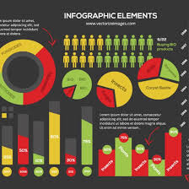

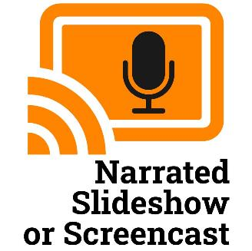
Barrier 5: Expressing and demonstrating learning
Solution: add submission modes
Notes:
So, you decide to expand the options for how students submit their next assignment to include a mini-presentation screencast option, or an infographic option. You notice that students with English as their second (or third) language really take you up on the opportunity to demonstrate their learning in a different format, and that students with more artistic backgrounds love distilling their knowledge into a visual format, which other students can then use.
Video/audio feedback in Canvas.

Slide 36
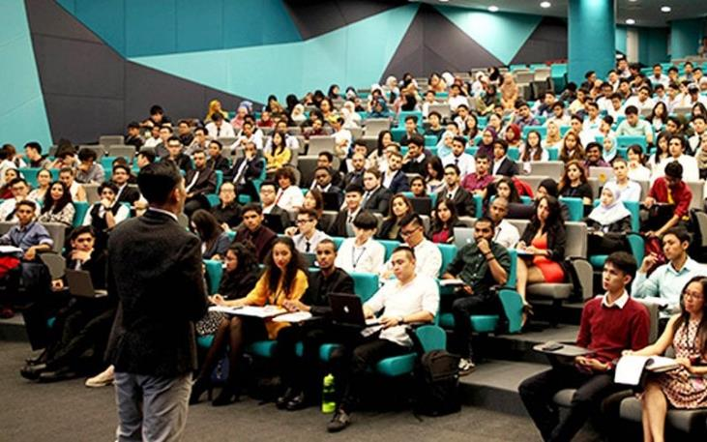
Barrier 6: Learning environment
Barrier: seeing slides from the back
Notes:
Students in the back of the classroom have a hard time hearing and get distracted by people around them doing off-task web browsing. The teacher gets a microphone, and sets a technology policy to support students throughout the lecture hall.
Other possible example: The instructor learns that students in the back of the classroom have a hard time seeing the slides to take notes. So the instructor starts posting the slides ahead of class. Now students in the back can pull the slides up on their own screen during class. Students in the front of the class also like the ability to take notes right on the slides, or pre-print the slides so they can avoid spending time copying down what is already on the slides and use their time adding additional notes.

Slide 37
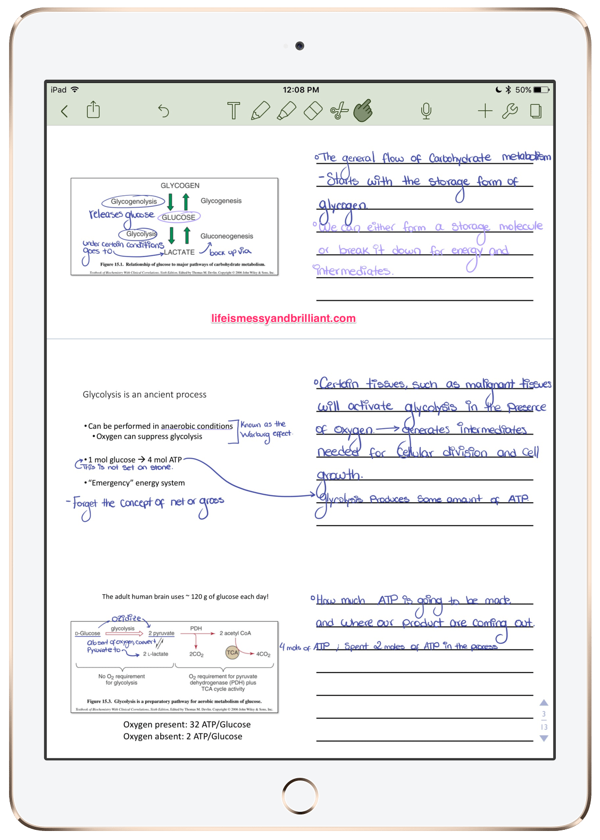
Barrier 6: Learning environment
Solution: sharing slides in advance
Notes:
Students in the back of the classroom have a hard time hearing and get distracted by people around them doing off-task web browsing. The teacher gets a microphone, and sets a technology policy to support students throughout the lecture hall.
Other possible example: The instructor learns that students in the back of the classroom have a hard time seeing the slides to take notes. So the instructor starts posting the slides ahead of class. Now students in the back can pull the slides up on their own screen during class. Students in the front of the class also like the ability to take notes right on the slides, or pre-print the slides so they can avoid spending time copying down what is already on the slides and use their time adding additional notes.
Providing the ppt file allowed students to choose format.

Slide 38
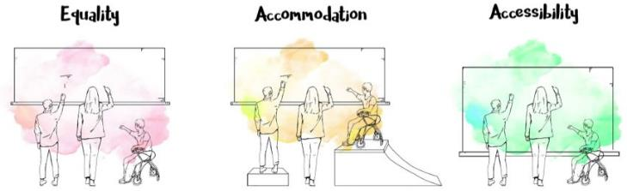
Practice applying UDL Considerations to remove barriers to learning in your course.
Access
Select one learning barrier you wrote down.
Match the learning barrier to one UDL Consideration that might mitigate or remove the barrier.
Using the UDL Consideration, design the change in your course.
Notes:
Grace
10-15 minutes
Turn off cameras and work in main session
(#2, select the best or most easily implemented Consideration.)

Slide 39

Celebrate!
Thanks for joining BIDA. You’ve already accomplished some UDL with your digital accessibility efforts!

Slide 40
Summer action
Support for your work this summer: AMP program
Apply to be a Digital Accessibility Ambassador by May 23rd
Reach out to your Instructional Designer
Notes:
AMP link: https://teaching.unl.edu/workshops/digital-accessibility-series/
Digital Accessibility Ambassador Application Link: https://unlcorexmuw.qualtrics.com/jfe/form/SV_8l804aOWxdaJ6iW
Instructional Designer Contact Link: https://teaching.unl.edu/contact-us/staff-directory/

Slide 41
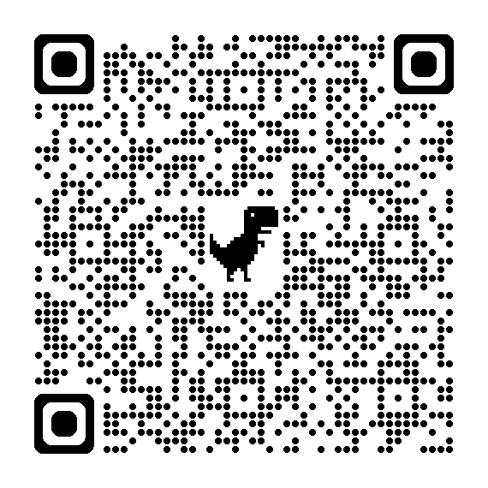
Thank you!
Please take a moment to complete this Qualtrics survey using the link or QR code.
Workshop Survey Link
Notes:
Links are updated 4/18/2025
Workshop survey link: https://ssp.qualtrics.com/jfe/form/SV_dmAoq33jrzkCCfs?workshop_title=Universal%20Design%20For%20Learning%20Workshop&academic_year=AY24-25

Slide 42
Closing UNL branding

Slide 43
Useful Resources to keep going with UDL
The UDL Guidelines (cast.org)
UDL Guidelines 3.0 Rationale - Google Docs
Meet with your instructional designer to get personalized help applying UDL in your course!

Slide 44
Learning Barriers & UDL Principles
Engagement | Representation | Action & Expression
Emotional & Motivational | Emotional & Motivational | Emotional & Motivational
Identity & Authentic Self | Identity & Authentic Self | Identity & Authentic Self
Interpersonal | Content | Expressing & Demonstrating Learning
Learning Environment |  | Learning Environment
Notes:
Zach
Brief overview of the principles

